Slide 1
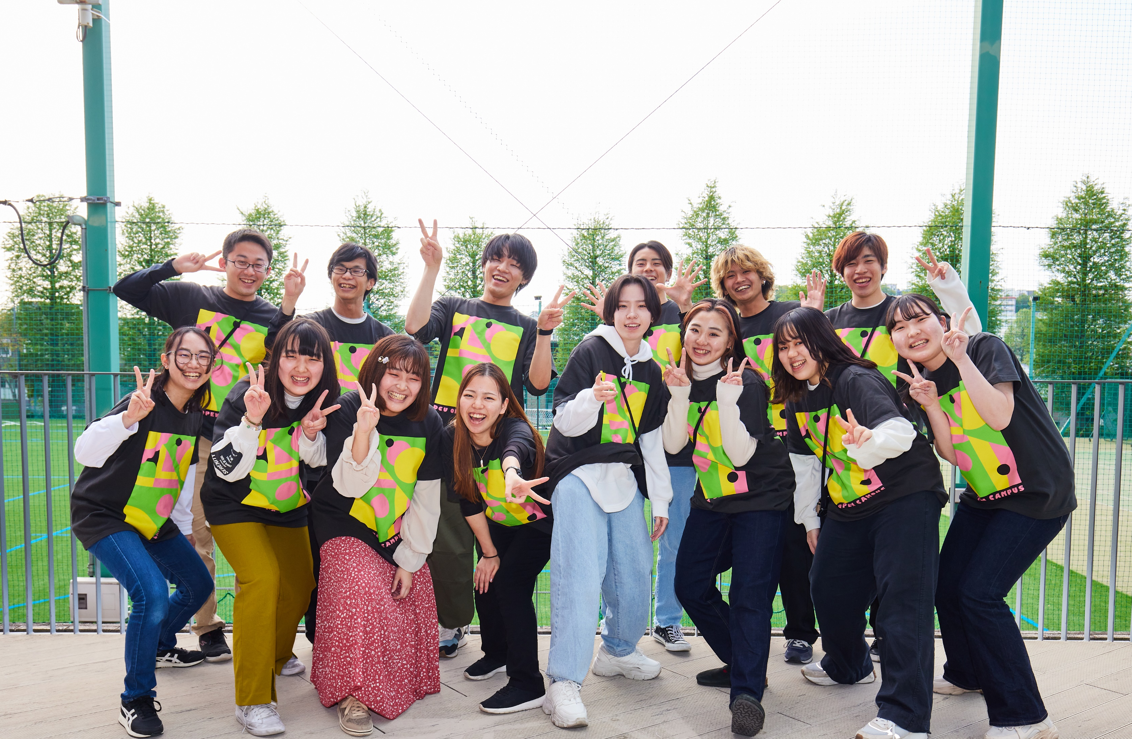
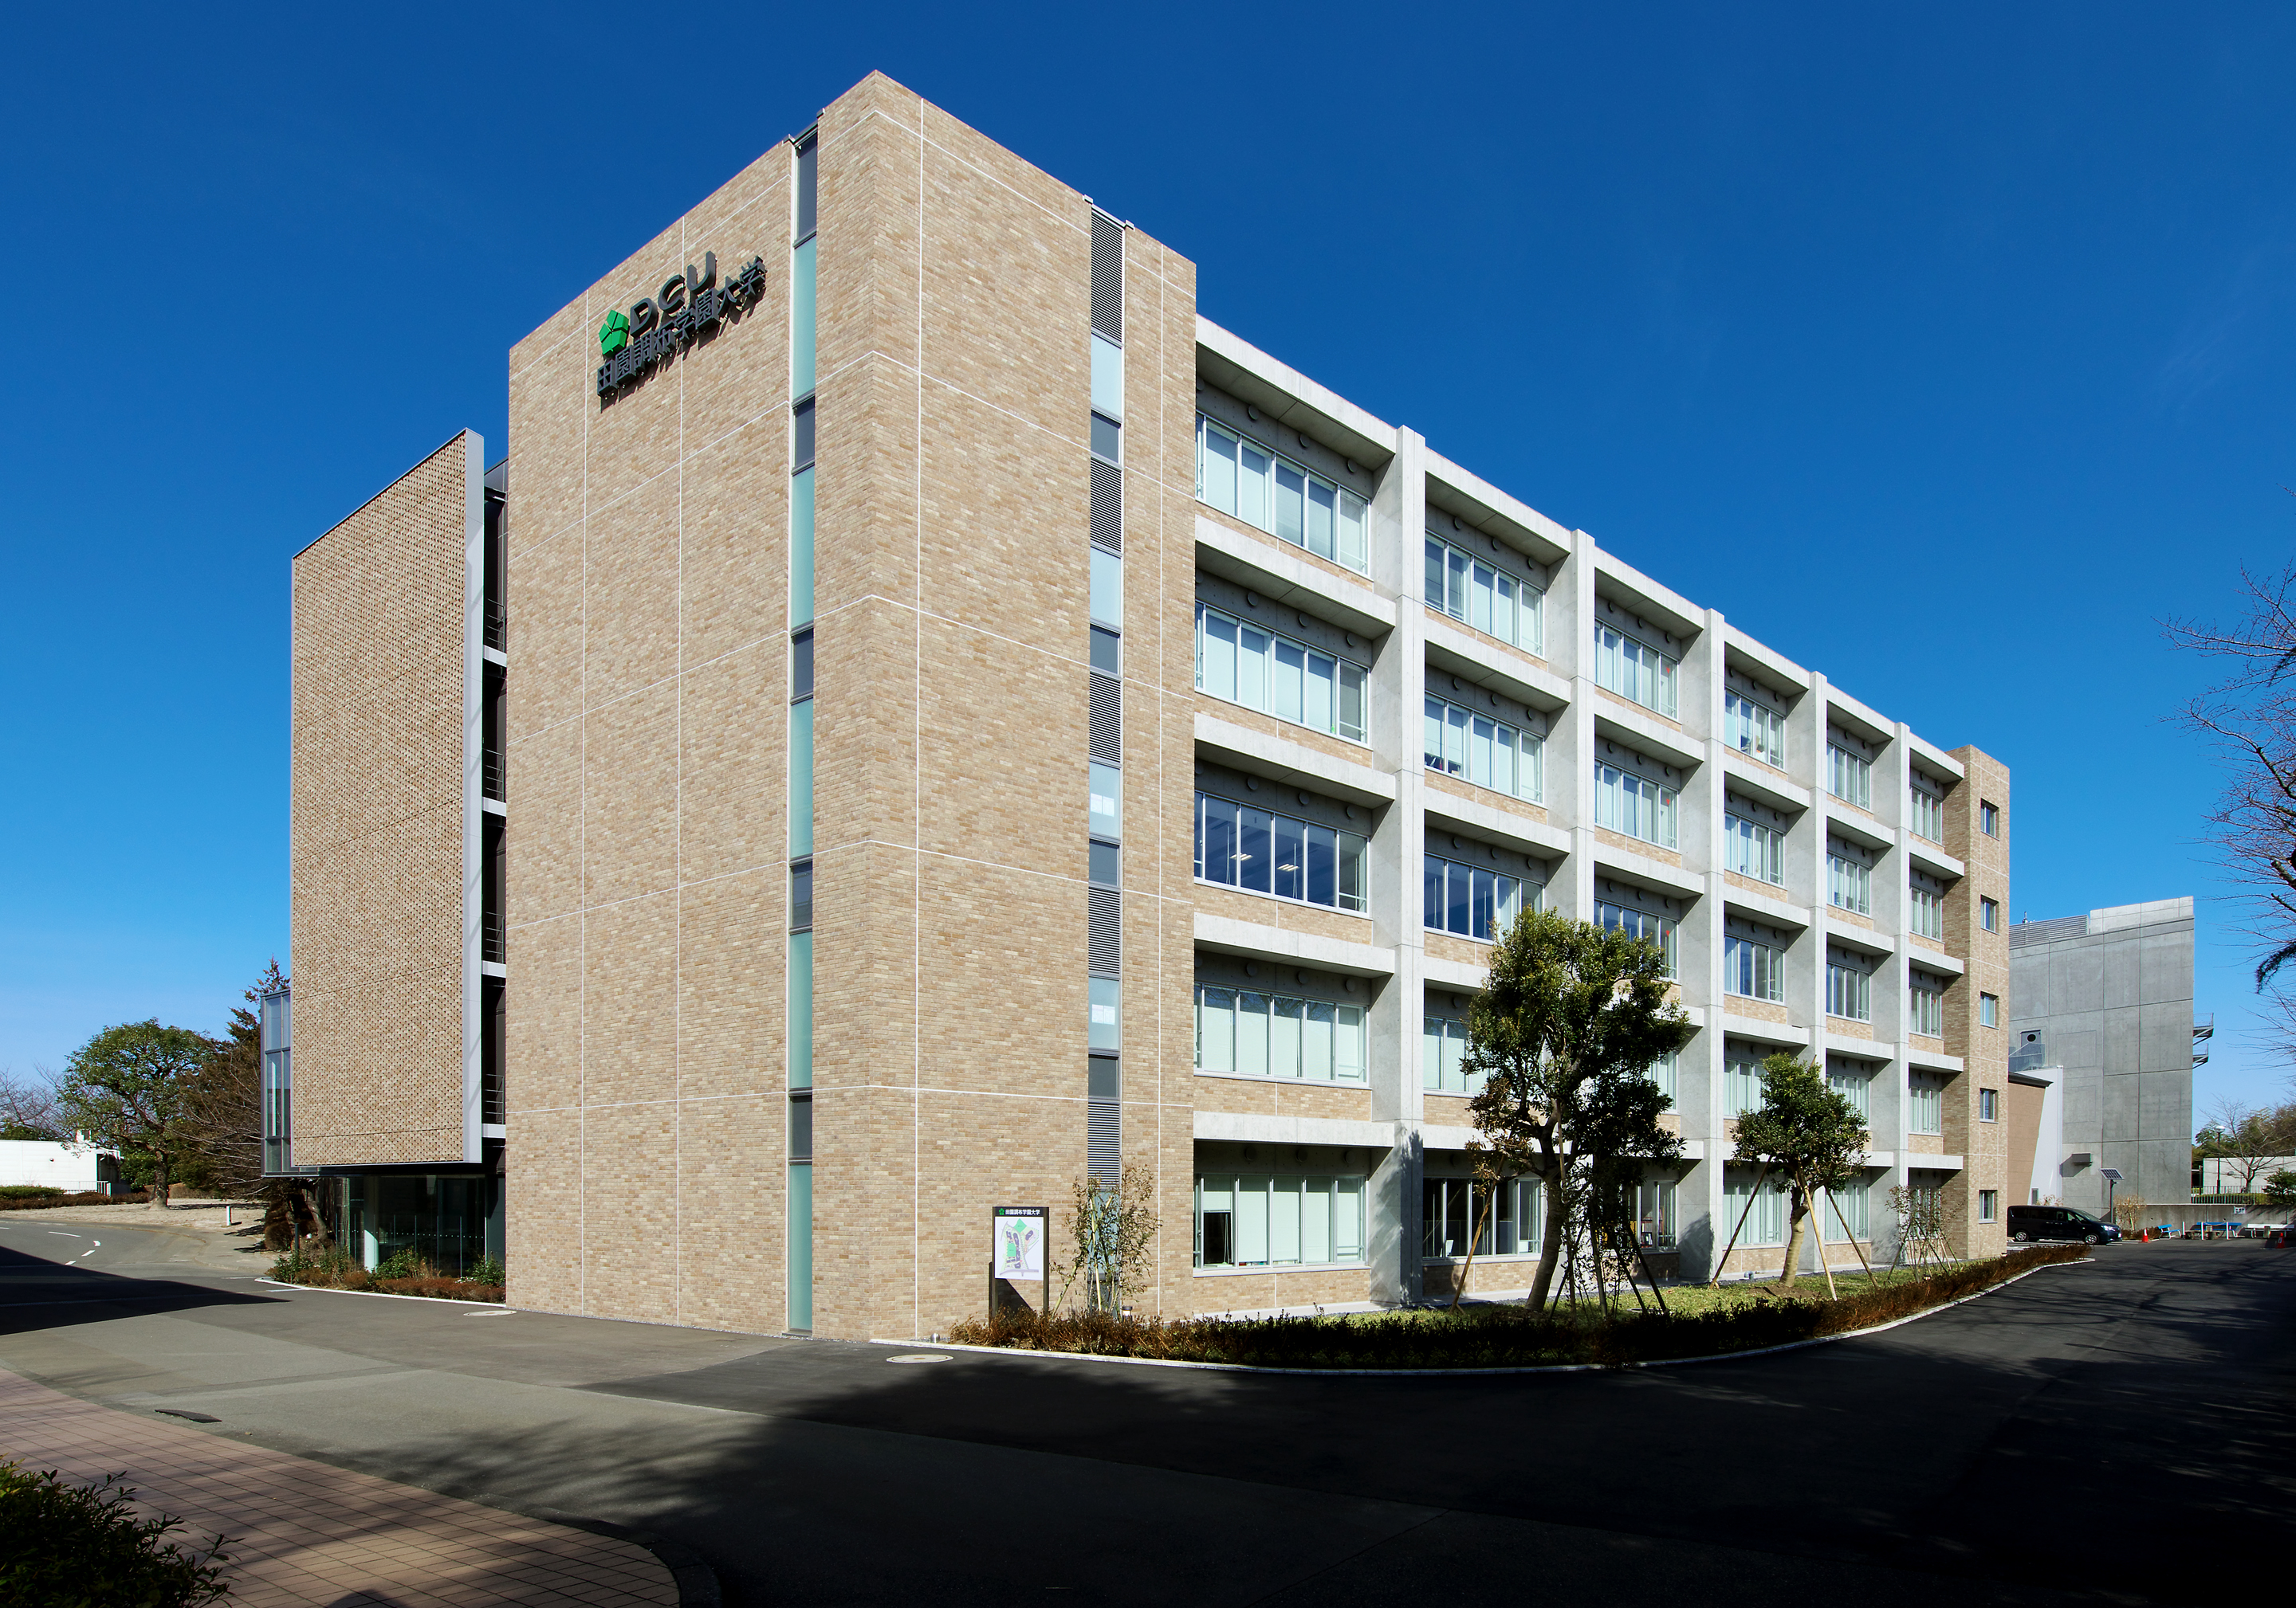
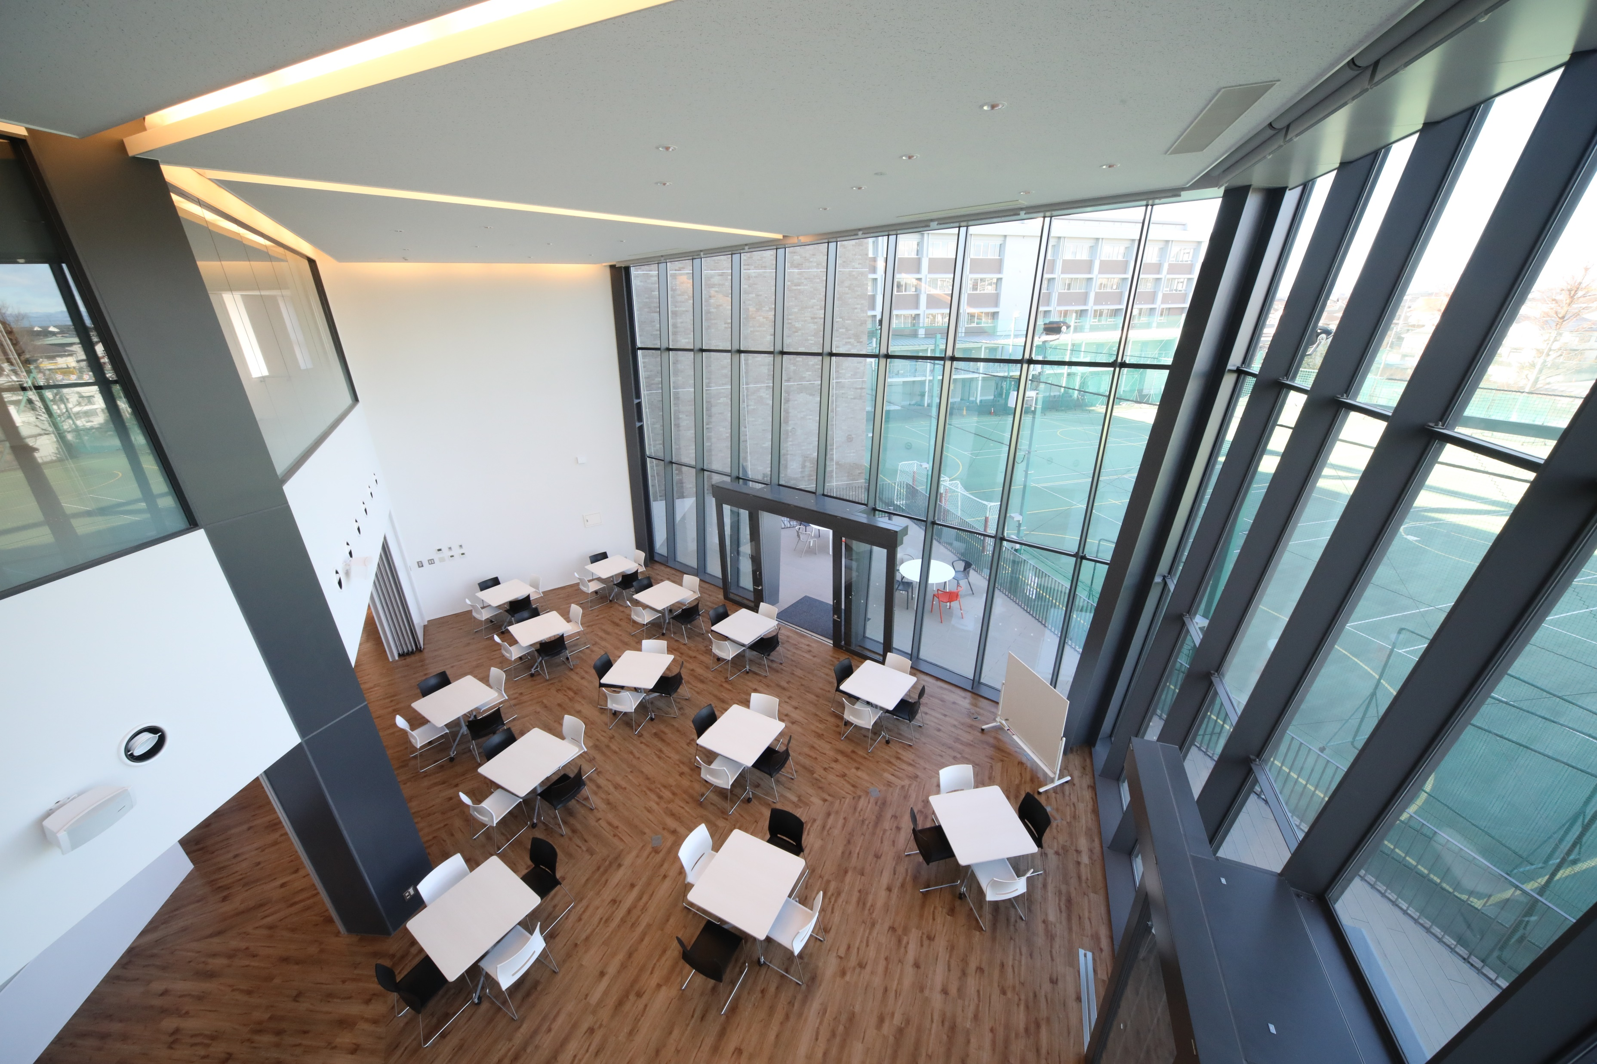

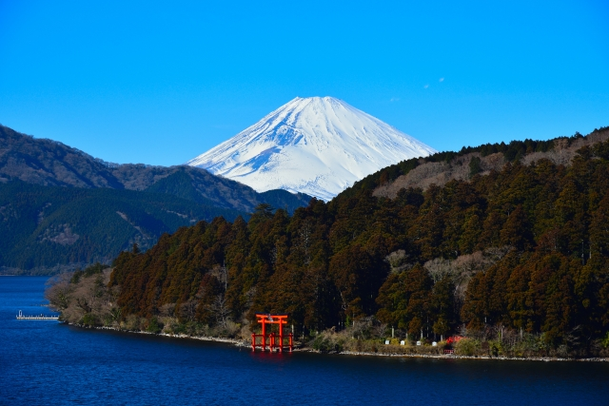

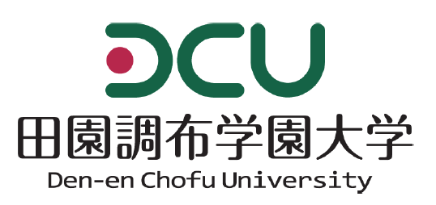
2023
Den-en Chofu University
Summer Program
Experience Japan with DCU
Japanese cultural experience
Basic Japanese Courses
City tour and Field trip
Participation is free! !
(program fee, tuition fee, accommodation fee, airport pick up service included)
Duration of the program: August 17～August 24, 2023
For more information, please contact
Office of International and Cross-Strait Affairs, Hungkuang University
Apply by June 22

